Slide 1
Minimum Edit Distance

Slide 2
String distance
Deciding which of two words is closer to some third word in spelling is a special case of the general problem of string distance.
The distance between two strings is a measure of how alike two strings are to each other.
Many important algorithms for finding string distance rely on some version of the minimum edit distance algorithm

Slide 3
How similar are two strings ?

Slide 4
Other uses of edit distance in NLP

Slide 5
Minimum Edit Distance
The minimum edit distance algorithm (Wagner and Fischer 1974)
The idea: the minimum edit distance between two strings is the minimum number of editing operations that need to transform one string into another.
The operations:
1. Insertion (i)
2. Deletion (d)
3. Substitution (s)

Slide 6
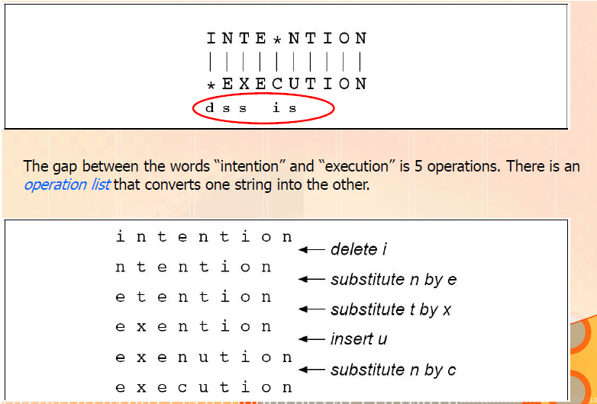
Minimum Edit Distance
Representing the minimum edit distance between two strings as an alignment.
The final row gives the operation list for converting the top string into the bottom
string;
Transformation from intention to execution

Slide 7
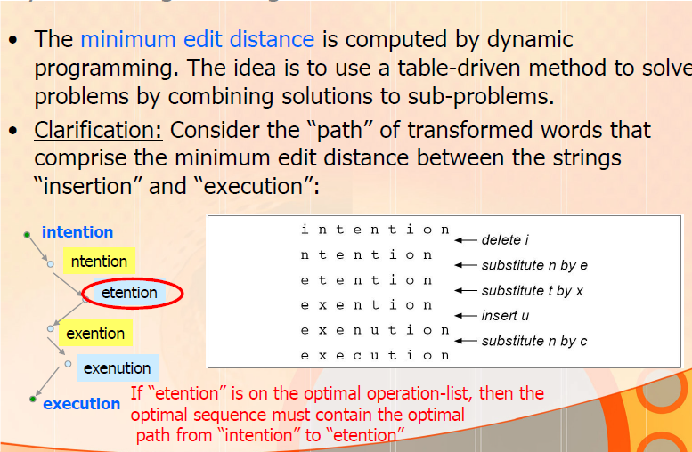
Dynamic Programming - Minimum Edit Distance

Slide 8
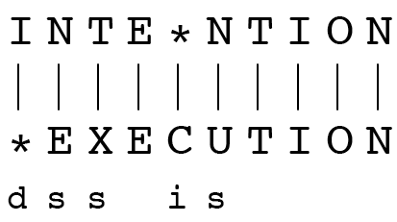
Minimum Edit Distance
If each operation has a cost of 1
Distance between these is 5
If substitutions cost 2 (Levenshtein distance metric)
Distance between them is 8
Each insertion or deletion has a cost of one
substitution has a cost of 2 (since any substitution can be represented by one insertion and one deletion).

Slide 9
Dynamic Programming - Minimum Edit Distance
The minimum edit distance is computed by dynamic programming.
Dynamic programming applies a table-driven method to solve problems by combining solutions to sub problems
The intuition of a dynamic programming problem is that a large problem can be solved by properly combining the solutions to various subproblems.

Slide 10
Dynamic Programming - Minimum Edit Distance
Dynamic programming algorithms for sequence comparison work by
creating a distance matrix with one column for each symbol in the target sequence and
one row for each symbol in the source sequence (i.e., target along the bottom, source along the side).
For minimum edit distance, this matrix is the edit-distance matrix.
Each cell edit-distance[i,j] contains the distance between the first i characters of the target and the first j characters of the source.
Each cell can be computed as a simple function of the surrounding cells;
thus starting from the beginning of the matrix it is possible to fill in every entry.

Slide 11
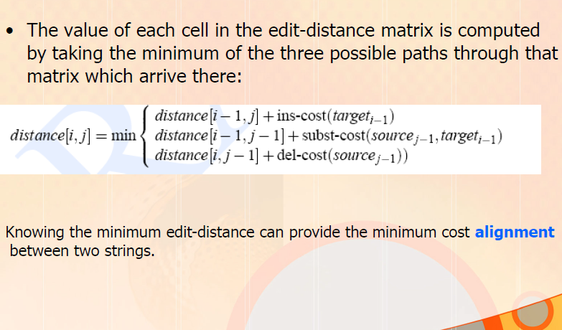
Dynamic Programming - Minimum Edit Distance

Slide 12
The Edit Distance Table
N | 9
O | 8
I | 7
T | 6
N | 5
E | 4
T | 3
N | 2
I | 1
# | 0 | 1 | 2 | 3 | 4 | 5 | 6 | 7 | 8 | 9
 | # | E | X | E | C | U | T | I | O | N
Note: initial values representing the distance from the empty string

Slide 13
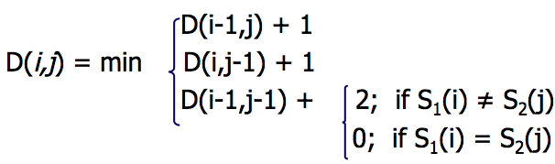
The Edit Distance Table
N | 9
O | 8
I | 7
T | 6
N | 5
E | 4
T | 3
N | 2
I | 1
# | 0 | 1 | 2 | 3 | 4 | 5 | 6 | 7 | 8 | 9
 | # | E | X | E | C | U | T | I | O | N
Note: assume that there is no cost for substituting a letter for itself (i.e. subst-cost(x, x) = 0)

Slide 14
Edit Distance
N | 9
O | 8
I | 7
T | 6
N | 5
E | 4
T | 3
N | 2
I | 1
# | 0 | 1 | 2 | 3 | 4 | 5 | 6 | 7 | 8 | 9
 | # | E | X | E | C | U | T | I | O | N

Slide 15
The Edit Distance Table
N | 9 | 8 | 9 | 10 | 11 | 12 | 11 | 10 | 9 | 8
O | 8 | 7 | 8 | 9 | 10 | 11 | 10 | 9 | 8 | 9
I | 7 | 6 | 7 | 8 | 9 | 10 | 9 | 8 | 9 | 10
T | 6 | 5 | 6 | 7 | 8 | 9 | 8 | 9 | 10 | 11
N | 5 | 4 | 5 | 6 | 7 | 8 | 9 | 10 | 11 | 10
E | 4 | 3 | 4 | 5 | 6 | 7 | 8 | 9 | 10 | 9
T | 3 | 4 | 5 | 6 | 7 | 8 | 7 | 8 | 9 | 8
N | 2 | 3 | 4 | 5 | 6 | 7 | 8 | 7 | 8 | 7
I | 1 | 2 | 3 | 4 | 5 | 6 | 7 | 6 | 7 | 8
# | 0 | 1 | 2 | 3 | 4 | 5 | 6 | 7 | 8 | 9
 | # | E | X | E | C | U | T | I | O | N

Slide 16
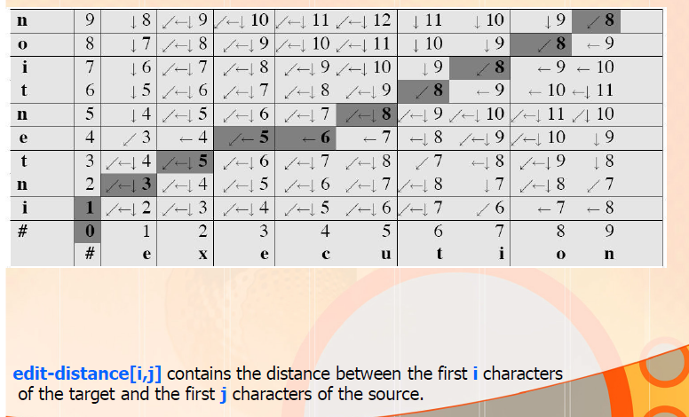
Minimum Edit Distance

Slide 17
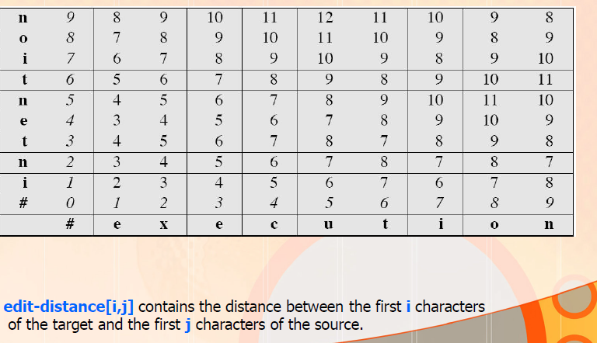
The Edit Distance Matrix - Minimum Edit Distance

Slide 18
Applications of MED Algm
Finding potential spelling error corrections
with a small change, it can also provide the minimum cost alignment between two strings.
In speech recognition, minimum edit distance alignment is used to compute word error rate in speech recognition
Alignment plays a role in machine translation, in which sentences in a parallel corpus (a corpus with a text in two languages) need to be matched up to each other.

Slide 19
Backtrace for Computing Alignments
To extend the edit distance algorithm to produce an alignment
start by visualizing an alignment as a path through the edit distance matrix

Slide 20
The Distance Matrix
Every non-decreasing path
from (0,0) to (M, N)
corresponds to
an alignment
of the two sequences
x₀ …………………… x_{N}
An optimal alignment is composed of optimal subalignments
y₀ ……………………………… y_{M}

Slide 21
Backtrace for Computing Alignments
Edit distance is not sufficient
We often need to align each character of the two strings to each other
We do this by keeping a “backtrace”
Every time we enter a cell, remember where we came from
When we reach the end,
Trace back the path from the upper right corner to read off the alignment

Slide 22
Backtrace for Computing Alignments
The intuition of how to compute the alignment path?
If two boldfaced cells occur in the same row, there will be an insertion in going from the source to the target
two boldfaced cells in the same column indicates a deletion.
The computation proceeds in two steps:
First step: store back pointers
augment the minimum edit distance algorithm to store backpointers in each cell.
The backpointer from a cell points to the previous cell (or cells) that were extended from in entering the current cell.
multiple backpointers mean that the minimum extension could have come from multiple previous cells.

Slide 23
Backtrace for Computing Alignments
Second step: Perform a backtrace
start from the last cell (at the final row and column) and
follow the pointers back through the dynamic programming matrix.
Each complete path between the final cell and the initial cell is a minimum distance alignment.
Problem: Modify the minimum edit distance algorithm to store the pointers and compute the backtrace to output an alignment.
The Viterbi algorithm is an extension of minimum edit distance
uses probabilistic definitions of the operations.
Instead of computing the “minimum edit distance” between two strings, we are interested in the “maximum probability alignment” of one string with another.

Slide 24
Minimum Edit Distance

Slide 25
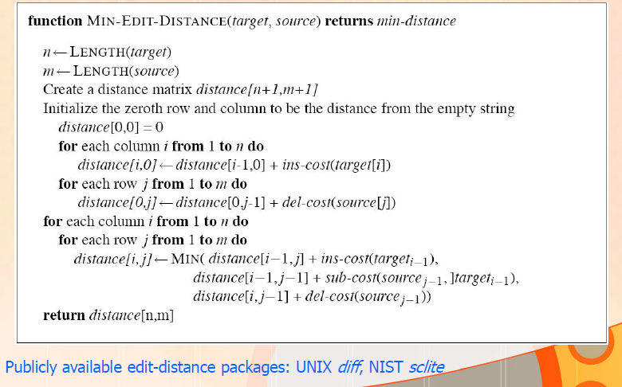
Minimum Edit Distance Algorithm

Slide 26
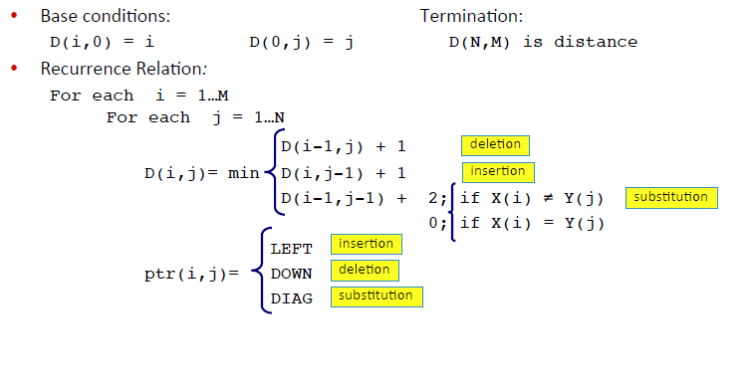
Backtrace – how to show arrows?
Note: convention for arrows – LEFT, DOWN, DIAG

Slide 27
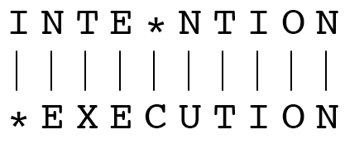
Minimum Edit Distance
Outputting the Alignment
Build the alignment from right to left.
Follow the backtrack pointers starting from entry (n,m).
If we follow a diagonal pointer, add both characters to the alignment,
If we follow a left pointer, add a gap to the source (y-axis) string and add the target (x axis) character
If we follow a down pointer, add the source (y-axis) character and add a gap to the target (x-axis) string

Slide 28
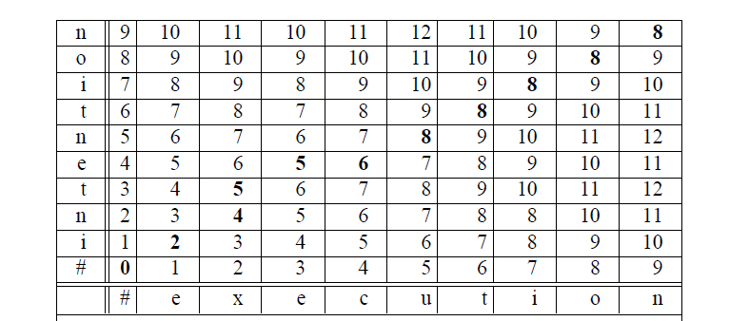
Minimum Edit Distance
Problem: Show alignment for the path: 8, 8, 8, 8, 8, 6, 5, 5, 4, 2, 0

Slide 29
Displaying the Alignment
i n t e * n t i o n
e x * e c u t i o n

Slide 30
Performance
Time: O(nm)
Space: O(nm)
Backtrace O(n+m)

Slide 31
Minimum Edit Distance – Bruteforce Recursive

Slide 32
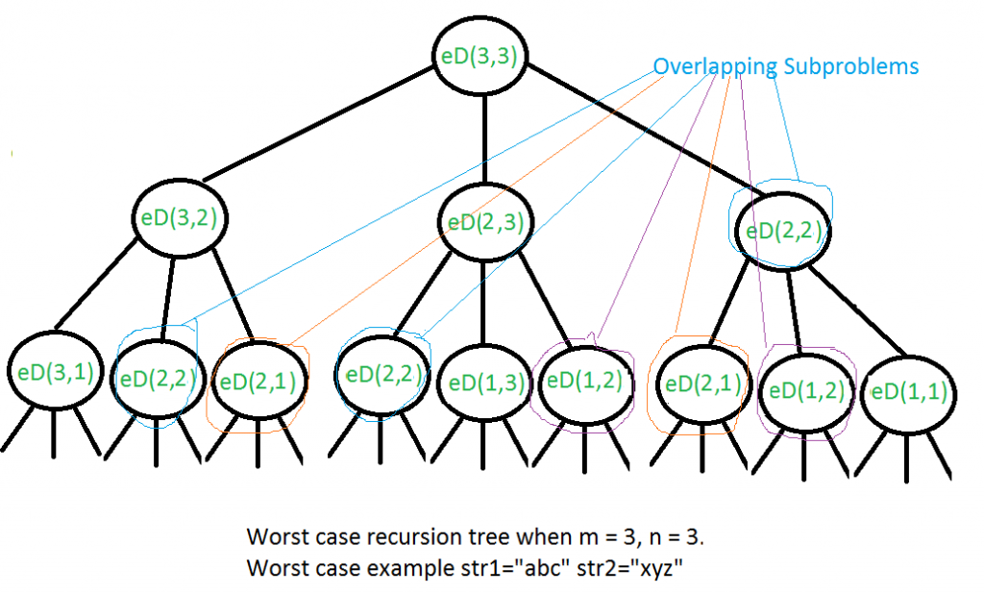
Minimum Edit Distance - Recursive call diagram for worst case
The time complexity of above solution is exponential.
In worst case, we need O(3^{m}) operations.
The worst case happens when none of characters of two strings match.

Slide 33
Minimum Edit Distance - Recursive call diagram for worst case
We can see that many subproblems are solved again and again
Ex: eD(2,2) is called three times
Since same suproblems are called again, this problem has Overlapping Subproblems property
So Edit Distance problem has properties of a dynamic programming problem
Like other typical Dynamic Programming(DP) problems, recomputations of same subproblems can be avoided by constructing a temporary array that stores results of subproblems

